Slide 1
Antibacterial Drug Discovery and Machine Learning
Michael Charlton

Slide 2
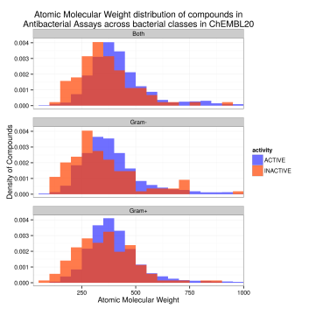
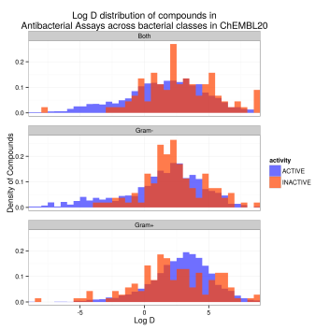
ChEMBL Physical Property Analysis
Ebejer et al. (J. Cheminformatics) extracted data from Chembl and assigned an anti-bacterial class
Antibacterial actives have similar distribution of physiochemical properties as the biochemical actives

Slide 3
ChEMBL Physical Property Analysis
We also examined TPSA, ring count and overall charge, but found no differences between the groups
Disagrees with previous analyses (O’Shea and Moser (2008) and Davies et al. (2014))
Postgres version of ChEMBL, RDKit, R
3-page SQL query
 | MW | LogD | LogP | HBA | HBD | RotB
Antibacterial | 385 | 2.8 | 3.2 | 6 | 2 | 5
Biochemical | 358 | 1.7 | 2.2 | 6 | 2 | 4

Slide 4
Does ElectroShape Describe Buglikeness?
ElectroShape
3D method for ligand-based searching
Captures shape and charge distribution
15 Descriptors
Close structural analogues removed from the two sets to avoid bias
Custom SVL code (Moe)
~12,000 entries including known and antibacterial drugs

Slide 5
Antibacterial assay
Biochemical assay
Antibacterial drugs

Slide 6
Analysis
Known antibacterial drugs do not span all of the space occupied by the antibacterial actives
Overall, antibacterials and biochemicals span the same space
Some areas are rich in antibacterial actives compared to biochemical actives
These areas tend to form islands rather than extended regions on the PC plot
Other areas are deficient in antibacterial actives
Self-organising Maps (SOMs, Kohonen maps) used to spot patterns in data (custom SVL code in Moe)

Slide 7
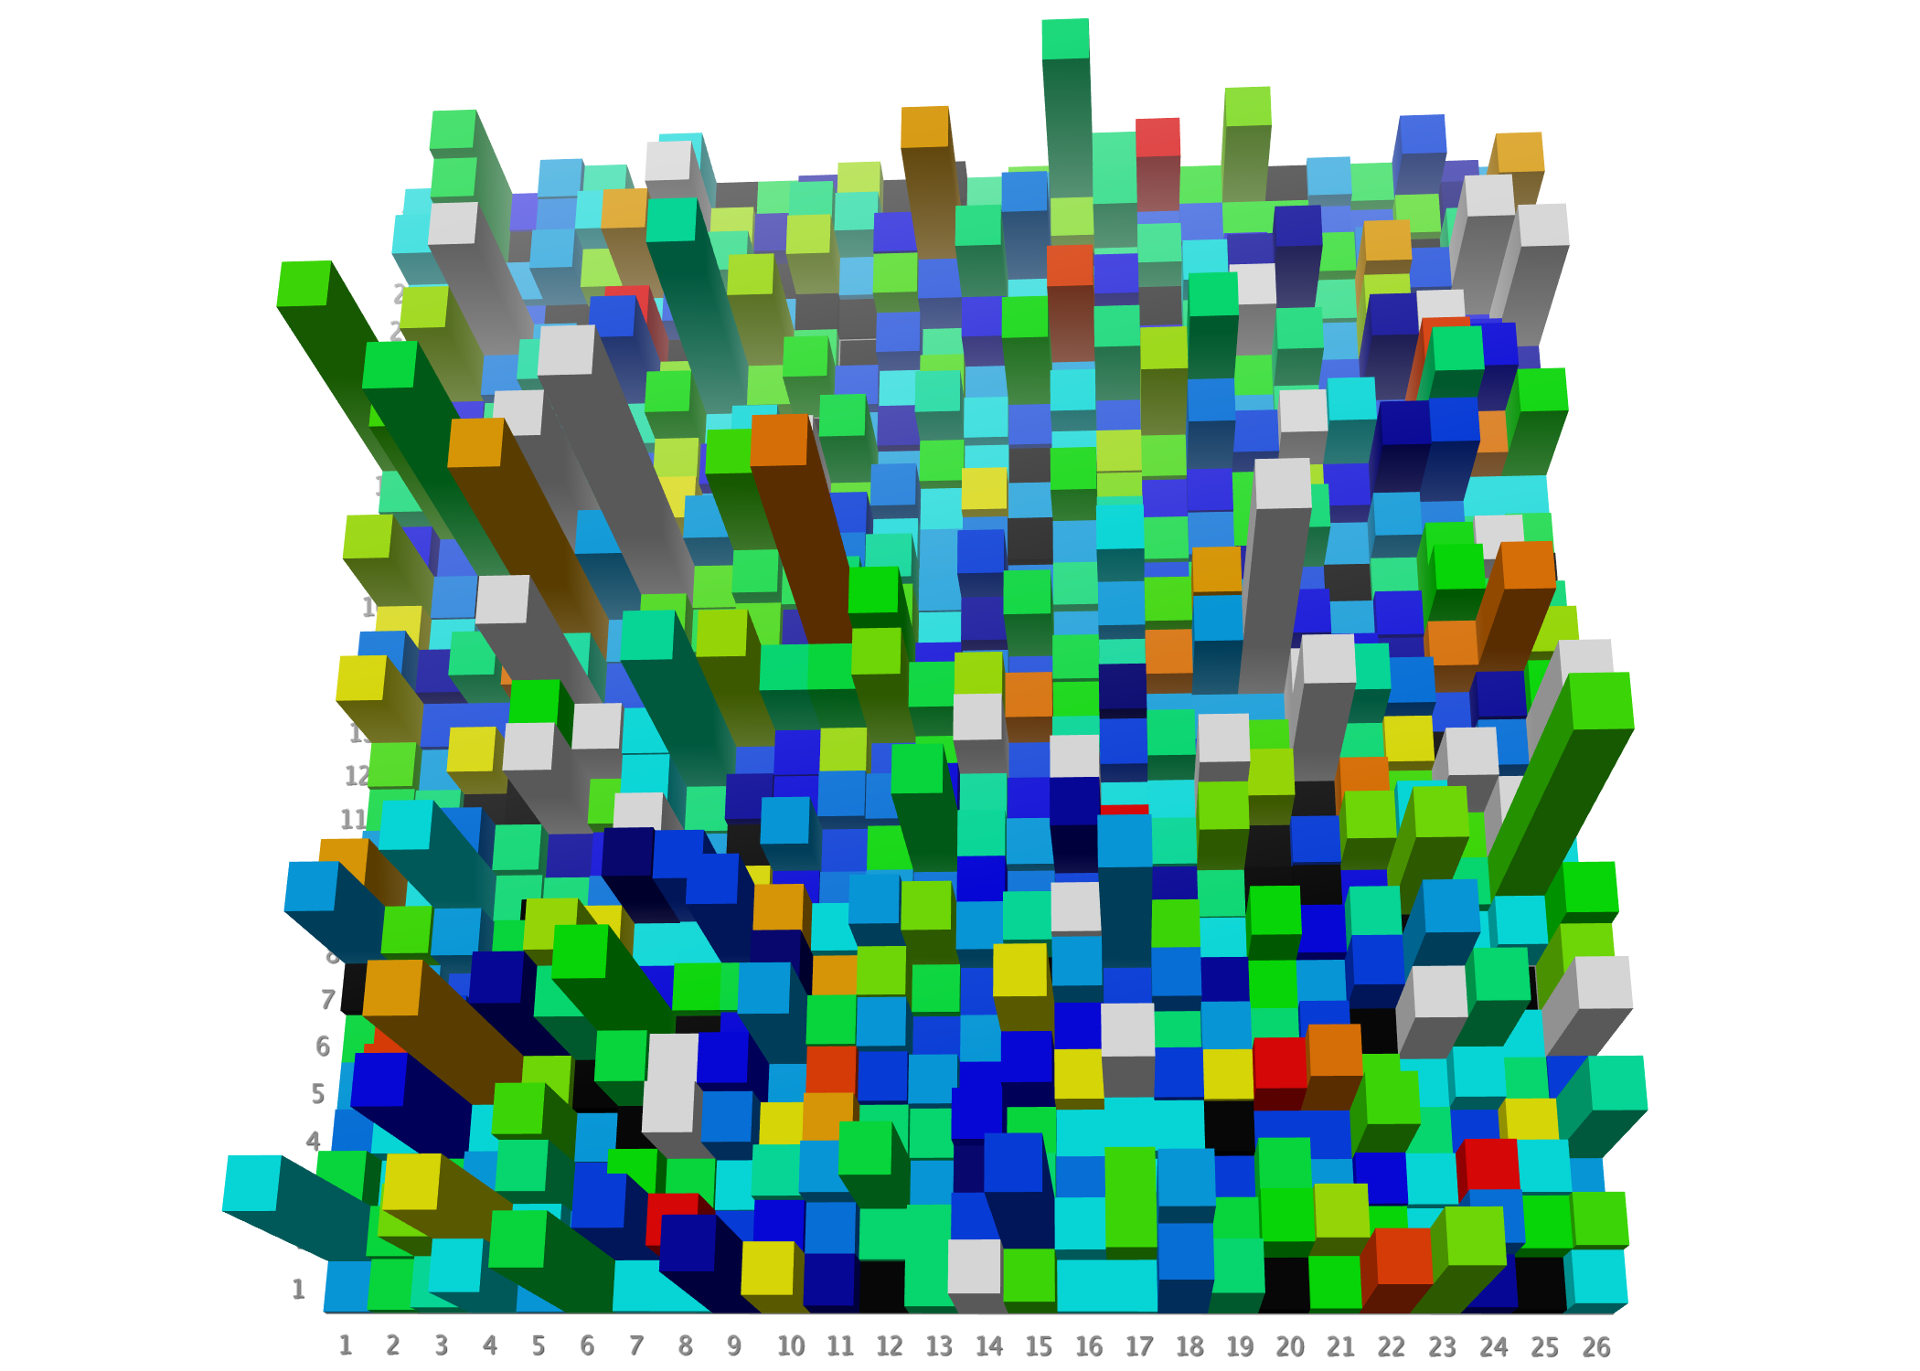
Example Network
Rendered with Moe /
SVL custom code
No actives Enrichment ratio : Low Medium High

Slide 8
Recall (ElectroShape, MMFF Charges)
Network Size | Update Range | Initialisation | Enriched Neurons | Compounds Retrieved
13 | 3* | Diverse | 18 | 2,876
16 | 3* | Diverse | 24 | 3,021
20 | 3* | Diverse | 36 | 2,423
25 | 3* | Random | 41 | 2,296
13 | 3* | Random | 28 | 2,246
16 | 3* | Random | 51 | 2,499
20 | 3* | Random | 71 | 2,404
13 | 4* | Diverse | 13 | 1,645
16 | 4* | Diverse | 22 | 2,256
20 | 4* | Diverse | 34 | 2,651
13 | 5 | Diverse | 17 | 2,143
16 | 5 | Diverse | 24 | 2,328
20 | 5 | Diverse | 37 | 2,759
* Negative update factor at outer level [1, 0.25, -0.1] or [1, 0.25, 0.1, -0.1]

Slide 9
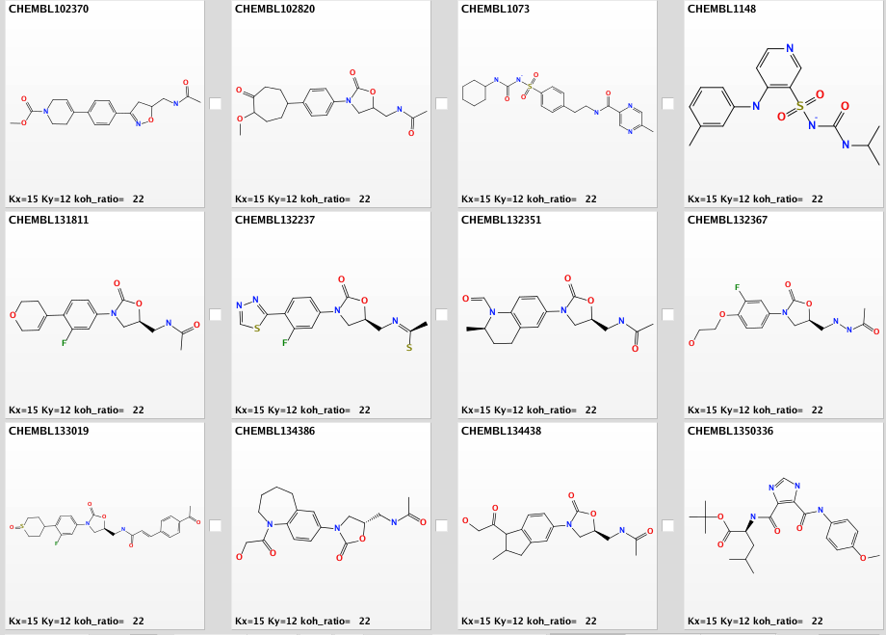
Some Neurons have Features in Common
Linezolid

Slide 10

Summary / Acknowledgements
Physical properties of antibacterials do not differ wildly from drug-like chemical space
ElectroShape can identify regions of space rich in antibacterials
Self-organising maps capture multi-dimensional nature of this space
Give separation of actives and inactives
Work was financially supported by the European Union via funding (HEALTH.2013.2.3.1-1:) of the EU FP7 project "NABARSI" (www.nabarsi.eu) under grant agreement number 601725

